Slide 1

Melbourne Workshops Nov 27 – 28
Melbourne Conference Nov 29 – 30
Brisbane Conference Dec 3 – 4
Brisbane Workshops Dec 5 – 6
Sydney Conference Dec 7 (TBC)
Sydney Workshops Dec 8
Follow us on Twitter @yow_oz
Tweet about YOW! Night #yownight
Join our Facebook and LinkedIn Groups

Slide 2
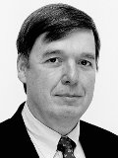
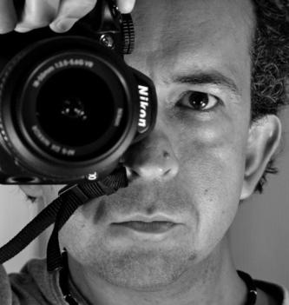
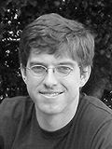
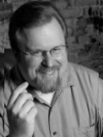
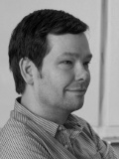
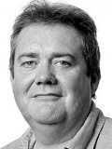
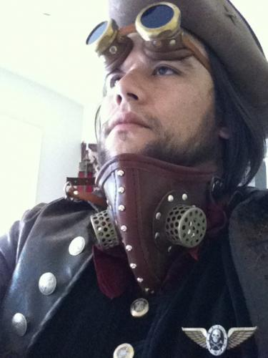
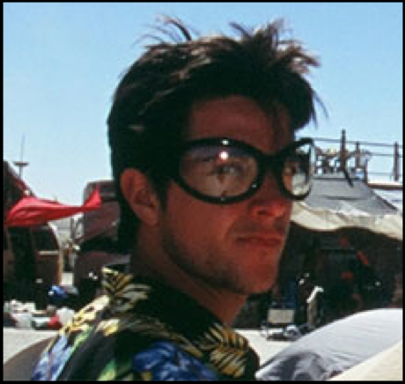


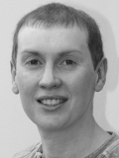
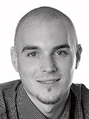
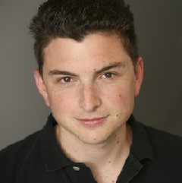
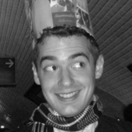
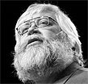
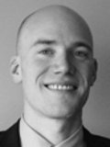
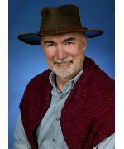
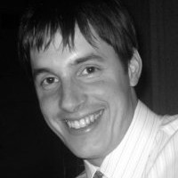
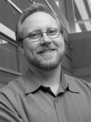
2012 Speakers
Don Reinertsen* Kevlin Henney* Bryan Cantrill* Michael Nygard Erik Doernenburg
Dave Farley Mike Lee Marko Rodriguez Fred George Mike Feathers
Martin Thompson Joe Duffy Mark McGranaghan Gary Bernhardt Jim Wierirch
Ron Bodkin Brian Beckman Kurt Schrader Jeff Patton
More to come!
*keynote speakers

Slide 3
2012 YOW! Keynotes
Don Reinertsen - Lean Product Expert and author Flow, The Decision Factory, Developing Products in Half The Time
http://www.reinertsenassociates.com/
Kevlin Henney - Global Speaker, OO Architecture and Design Expert, Consultant and Author/Editor Pattern Languages, 97 Things Every …
http://www.two-sdg.demon.co.uk/curbralan/index.html
Bryan Cantrill - VP Engineering Joyent.com, developer of award winning Dtrace, Performance Expert, ACM Queue Editorial Board, Sun Solaris and Sun Storage System architect, designer and developer
The Observation Deck http://dtrace.org/blogs/bmc/

Slide 4
Partial List of Speakers
Michael Nygard - author of Release IT, Beautiful Architecture, DevOps and Architecture Expert, Erik Doernenburg – veteran developer, TDD expert, visualization of architecture and development Dave Farley – co-inventor of Disruptor, author and performance expert; Mike Lee - Mayor of Apsterdam, Mobile Application Product Expert; Marko Rodriguez - developer of Gremlin, expert in Graph Databases; Fred George – Seasoned Software Leader, Large Scale Development, Programmer Anarchy and Micro Service Architectures, Mike Feathers – OO Design and Development Thought Leader, C++, Ruby. Legacy expert; Martin Thompson – Challenging Performance Myths, co-inventor Disruptor, High Performance Trading systems, Joe Duffy MS Concurent and CLR Runtime Architecture, next generation OS.., Mark McGranaghan Scaling Challenges at Heroku, Gary Bernhardt, Popular Ruby Speaker and Webcaster, Jim Wierirch Chief Scientist EdgeCase, Rails Thought Leader, Ron Bodkin CEO Think Analytics, Big Data Integration Expert, innovator in AOP, Brian Beckman - MS, Game Physics, Link, Cloud Computing, Kurt Schrader VP Engineering, Managing High Performance Ad Servers and Data Scientists, Jeff Patton Agile Product Design and UX Thought Leader

